Slide 1
Software Project Management
Chapter 4. Project Schedules

Slide 2
Building the Project Schedule
Allocate Resources to the Tasks
Identify Dependencies
Create the Schedule
Reconcile the Schedule with the Organization’s Needs
Add Review Meetings to the Schedule
Optimize the Schedule
Don’t Abuse Buffers
Track the Performance of the Project

Slide 3
Create the Schedule
The most common form for the schedule to take is a Gantt chart.
This is a type of bar chart developed by Henry Laurence Gantt, an American engineer who was prominent during the first two decades of the 20th century.

Slide 4
Continue…
Each task is represented by a bar, and the dependencies between tasks are represented by arrows.
Each arrow either points to the start or the end of the task, depending on the type of predecessor.
The black diamond between tasks D and E is a milestone, or a task with no duration.
Milestones are used to show important events in the schedule.
The black bar above tasks D and E is a summary task, which shows that these tasks are two subtasks of the same parent task.

Slide 5
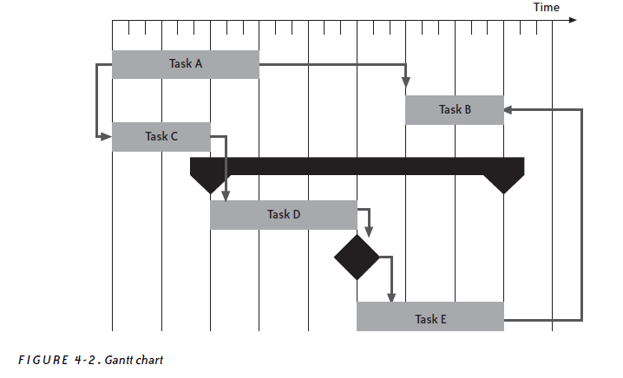

Slide 6
Reconcile the Schedule with the Organization’s Needs
Once all of the task durations and predecessors have been determined, the project management software can calculate an expected due date for the project.
If this date does not fit with the needs of the organization or the project stakeholders, the project manager should first go back to the resource list to see if the tasks can be reallocated more efficiently.

Slide 7
Continue…
One way to do this is to look for large gaps in the schedule; sometimes a small shift or swap in resources can close those gaps.
Another way to deal with a schedule that runs past a non-negotiable due date is to add or rearrange resources (if available).
Sometimes there are technical solutions that can help reduce the schedule. It may be possible to return to the assumptions generated during the estimation session. There may be an implementation approach that can be revisited.
The project can be released in several phases

Slide 8
Add Review Meetings to the Schedule
Progress reviews should be held regularly, both to keep track of whether the schedule is accurate and to plan action if the project goes off course.
To make sure a status meeting functions as an effective schedule review, the project manager must make sure that the agenda at every meeting includes a discussion of whether the project is still on track.
The result of this meeting will usually be an adjusted project schedule.

Slide 9
Continue…
Milestone reviews are meetings that the project manager schedules in advance to agree with project events.
The most common way for project managers to handle milestone reviews is to schedule them to occur after the last task in a project phase.
The difference between a milestone review and a progress one is that the project manager writes up a report after the milestone review.

Slide 10
Optimize the Schedule
Many times, the project manager has options in how the schedule is arranged.
There is often flexibility in the order in which the tasks may be performed, or to whom they may be assigned.
Most schedules end up with several sequences of interrelated tasks

Slide 11
Slack
In many schedules, there is some slack in these sequences.
In a sequence of tasks, slack is the amount of time that any of the tasks can be delayed without causing the due date of the final task in the sequence to be delayed as well.
A tight schedule has very little slack; a delay in any task will cause a delay in the due date.

Slide 12
Critical Path
One important tool for optimizing the schedule is the critical path.
The critical path is the sequence of tasks that represents the minimum time required to complete the project.
It is the sequence that, if delayed, will delay the schedule.
The last task on the critical path is always the last task in the schedule—when the critical path is completed, the project is done.

Slide 13
Continue…
Every project schedule has at least one critical path: most have exactly one, but some may have two or more critical paths that complete simultaneously at the end of the project.
There is never slack in the critical path.
It is very important to monitor the critical path closely. If a task that is on the critical path is late, the project will be delayed
Some project management software packages highlight the critical path on the Gantt chart—this is an especially useful feature that allows the project manager to optimize the chart visually.

Slide 14
Don’t Abuse Buffers
Many project managers commonly add buffers to their schedules.
A buffer is a task added to the schedule with no specific purpose except to account for unexpected delays.
There are times when buffers are useful.
There are many times when buffers are abused.

